Slide 1




Week-8 (Discussion)
16th September, 2024
Introduction to Machine Learning
Prof. Balaraman Ravindran
Professor and Head of the Department
Department of Data Science and Artificial Intelligence
IIT Madras
Ayan Paul
PMRF Research Scholar
IIT Kharagpur

Slide 2
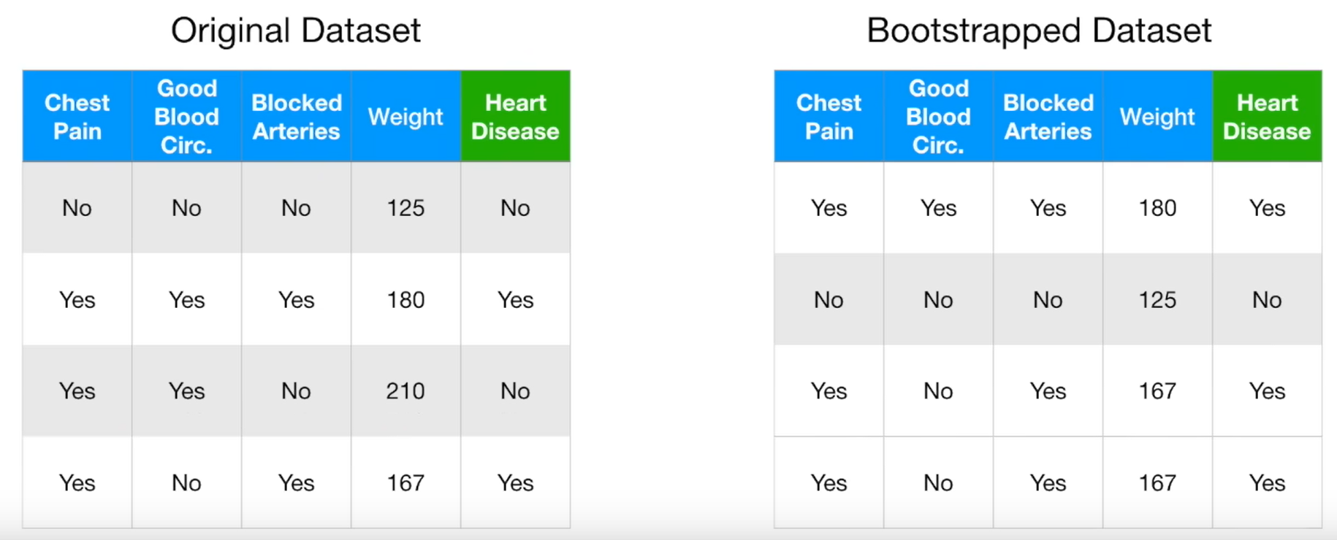
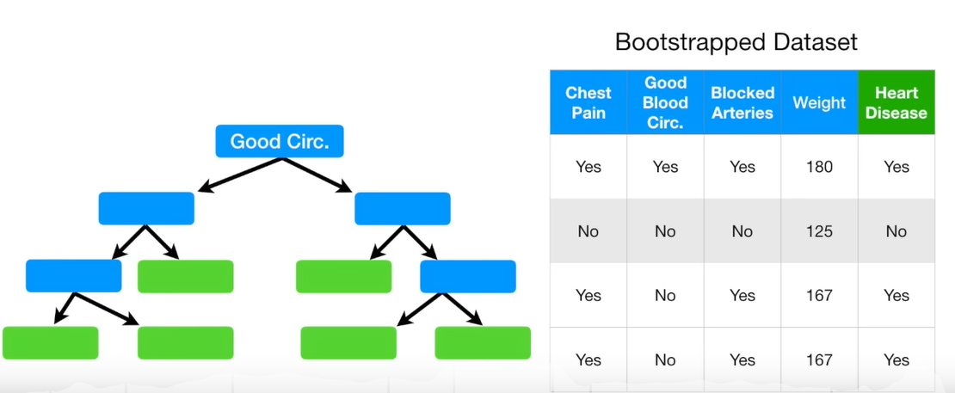
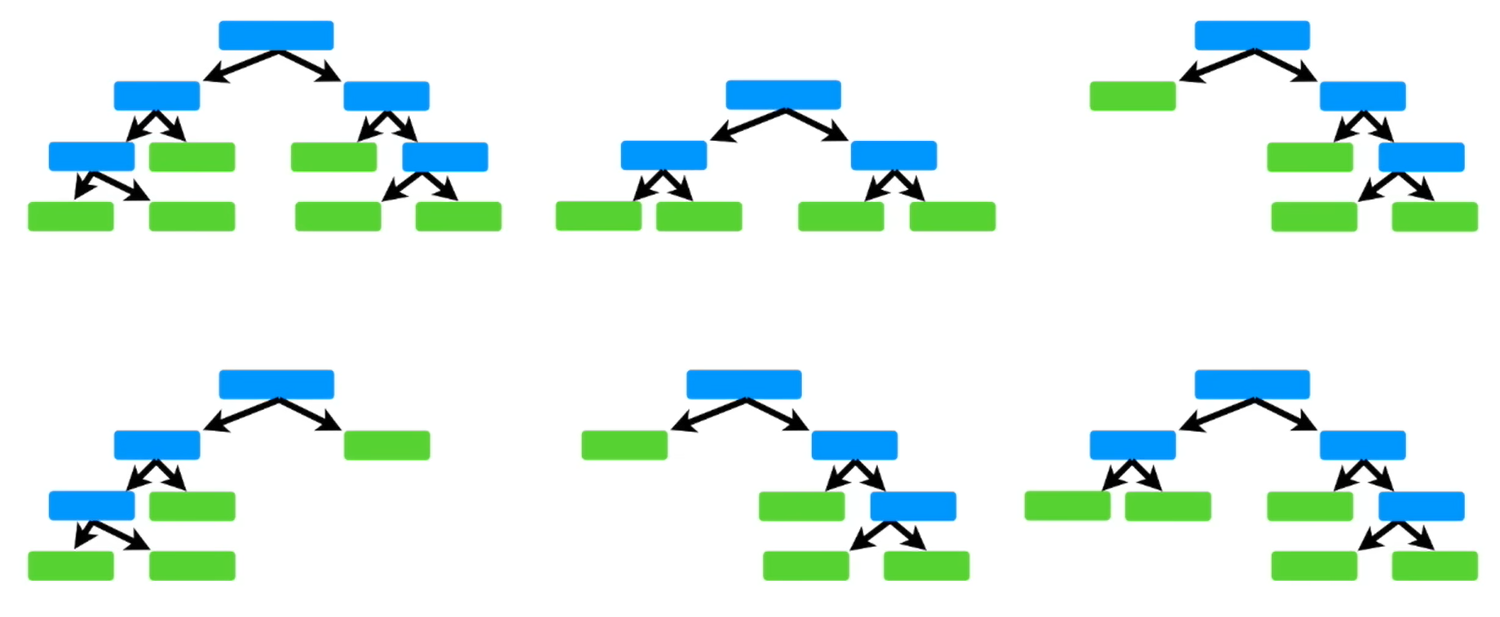
Problem with Decision Tree
They work great with data used to create them, but are not flexible when it comes to classifying new samples.
Random Forest
Random Forests combine simplicity of decision trees with flexibility resulting in vast improvement of accuracy
Random Forest is a classifier that contains a number of decision trees on various subsets of the given dataset.
Steps to create the Forest
Create a bootstrapped dataset
Create a decision tree using the bootstrapped dataset, but only use a random subset of variables at each step of creating the tree
Go to step1 and repeat: Make anew bootstrapped dataset and build a tree considering a subset of variables at each step. Ideally you do this for 100 of times.
Predict the final output based on majority votes of prediction from each tree →RF is an example of Bagging

Slide 3
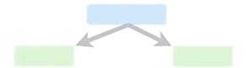
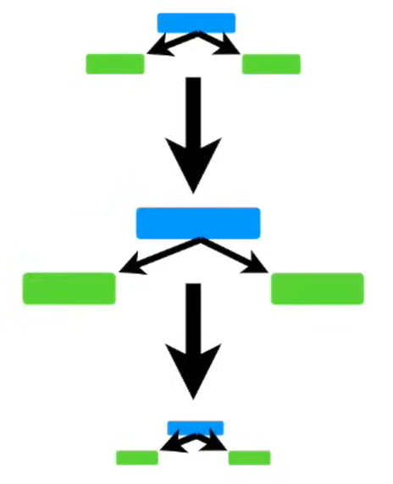
AdaBoost vs Gradient Boosting
AdaBoost
An ensemble technique, where, each weak learner is developed as decision stumps (A stump is a tree with just a single split and two terminal nodes) that are used to classify the observations.
In contrary to the random forest, here each classifier has different weights assigned to it based on the classifier’s performance (more weight is assigned to the classifier when accuracy is more and vice-verse)
Weights are also assigned to the observations at the end of every round, in such a way that wrongly predicted observations have increased weight resulting in their probability of being picked more often in the next classifier’s sample.

Slide 4
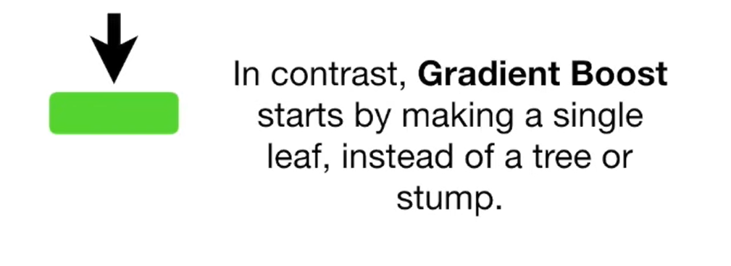
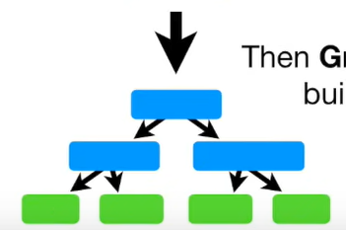
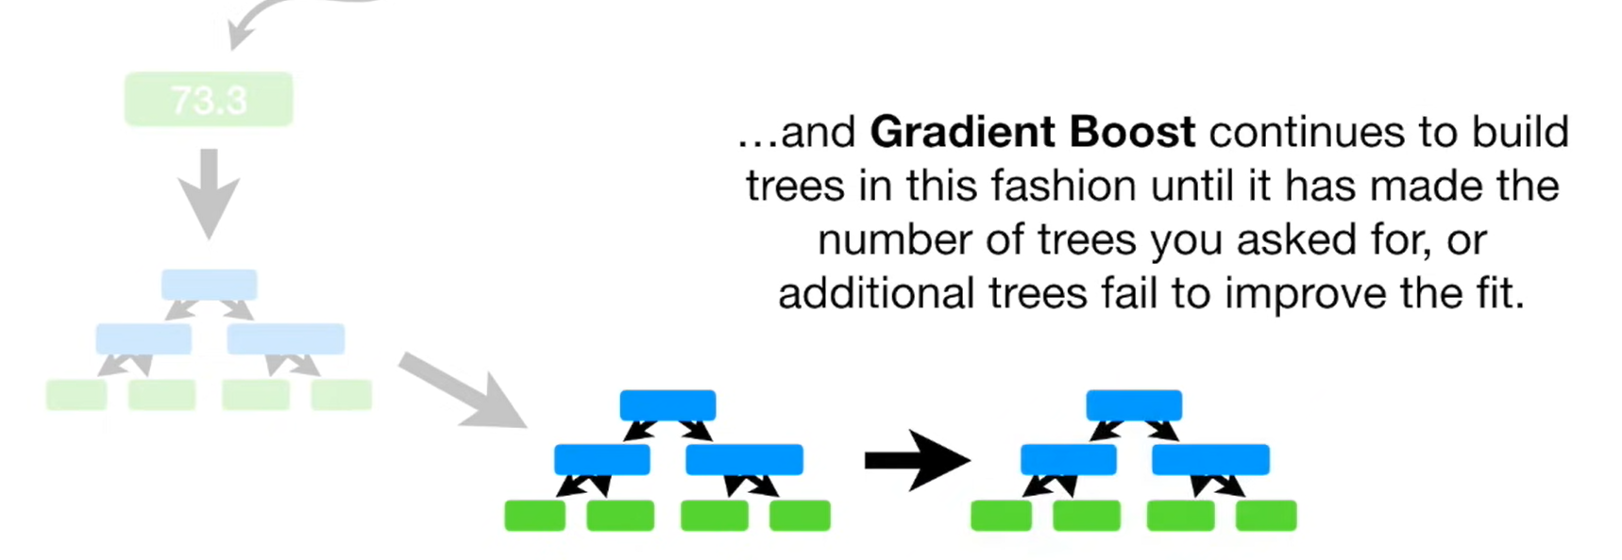
Gradient Boosting
Gradient Boost is an ensemble technique like AdaBoost. It starts with a leaf that predicts the average output (regression) or log(odds) (classification). Then, residuals from the current classifier become inputs for the next classifier, building trees step by step.
Learning rate helps capture maximum variance by adjusting the model gradually.- Moves in the direction opposite to the negative gradient to reduce loss, similar to Gradient Descent.
Usually, in GBM, every tree is grown with 8-32 terminal nodes, and around 100 trees are grown. Unlike Adaboost, here all the trees are given equal weights.

Slide 5
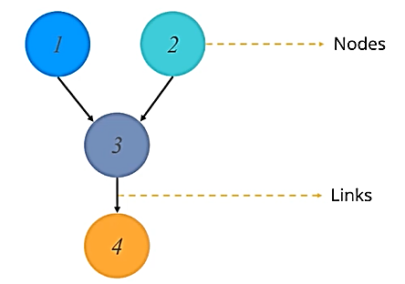
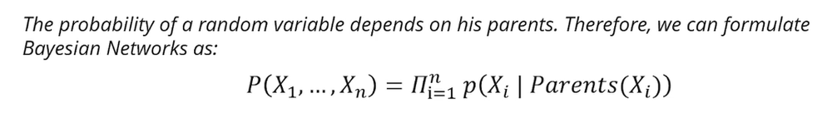
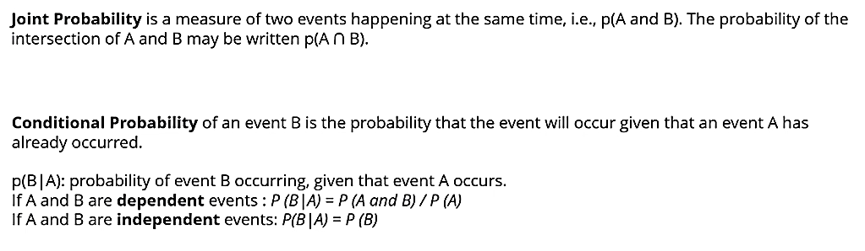
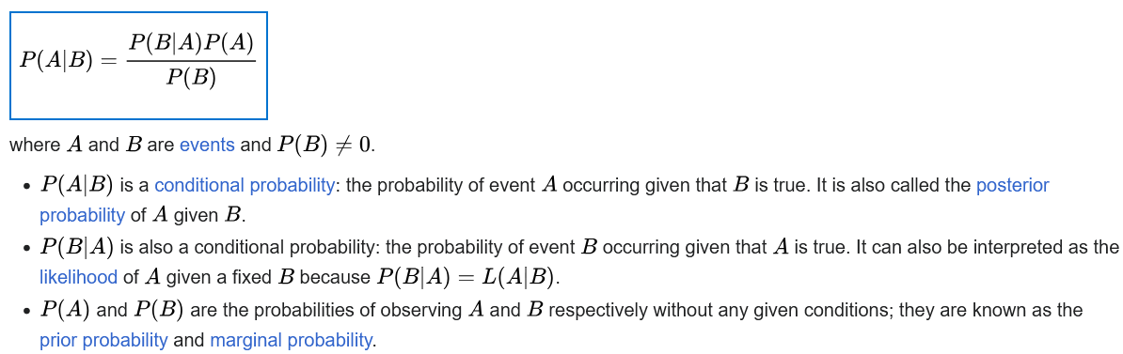
Bayesian Network
A Bayesian network (also known as a Bayes network, Bayes net, belief network, or decision network) is a probabilistic graphical model that represents a set of variables and their conditional dependencies via a directed acyclic graph (DAG).
A DAG contains set of nodes and links where each links relationship between the nodes.
Probability Types
Bayes Theorem
Bayes' theorem gives a mathematical rule for inverting conditional probabilities, allowing us to find the probability of a cause given its effect.

Slide 6
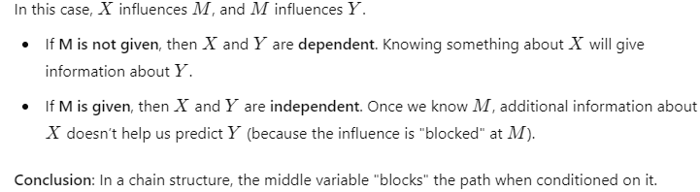
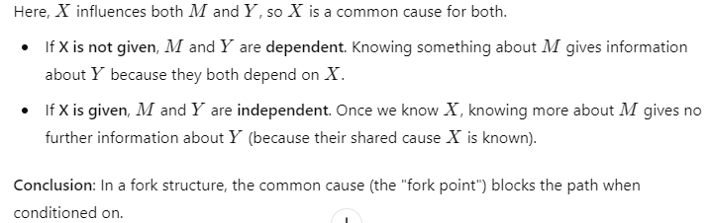
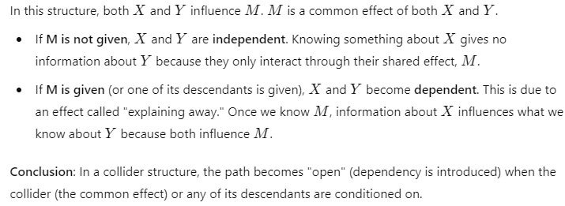
d-Separation
d-separation is a concept in Bayesian networks that helps determine whether two variables are conditionally independent given some set of other variables.
It stands for directional separation and is used to analyze the dependencies and independencies in a directed acyclic graph (DAG).
Rules of d-Separation

Slide 7
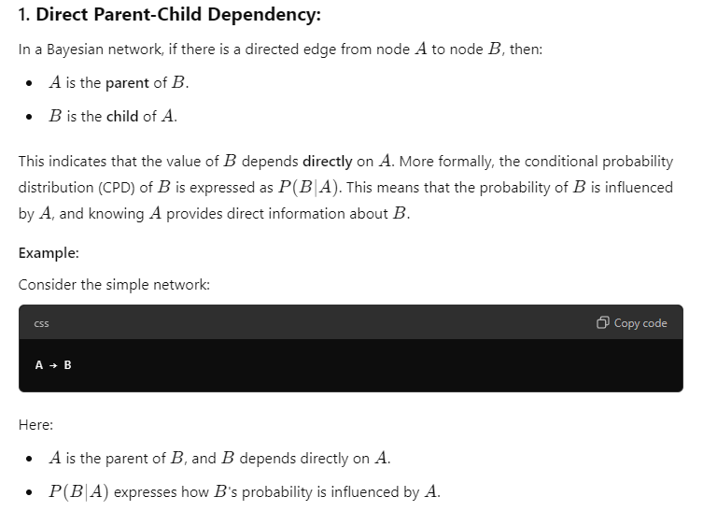
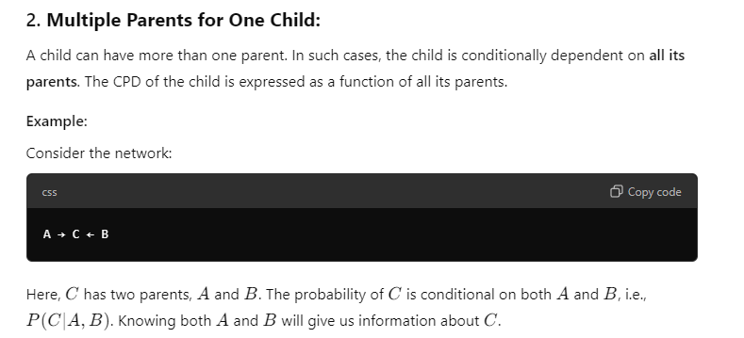
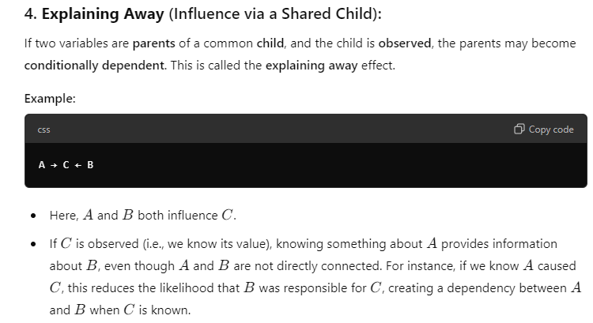
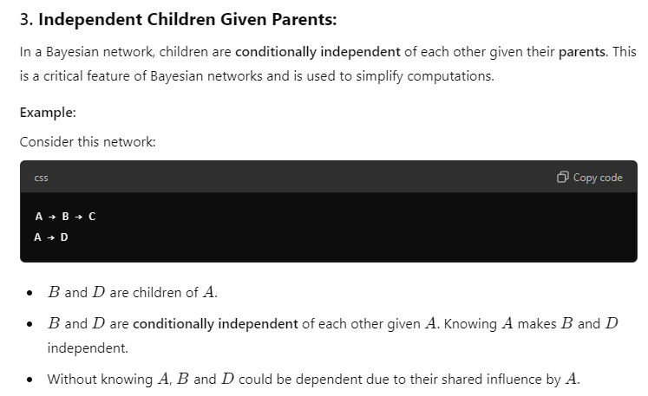
Parent Child Relationship

Slide 8
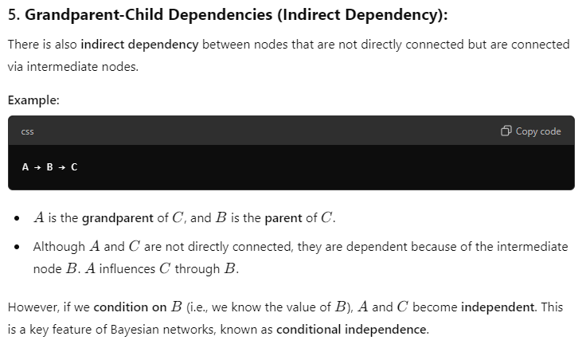

Slide 9
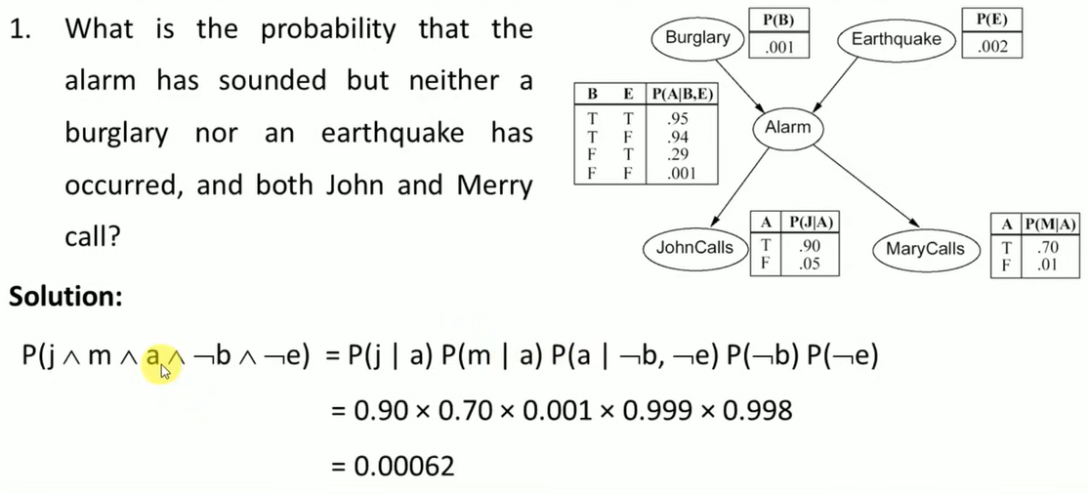
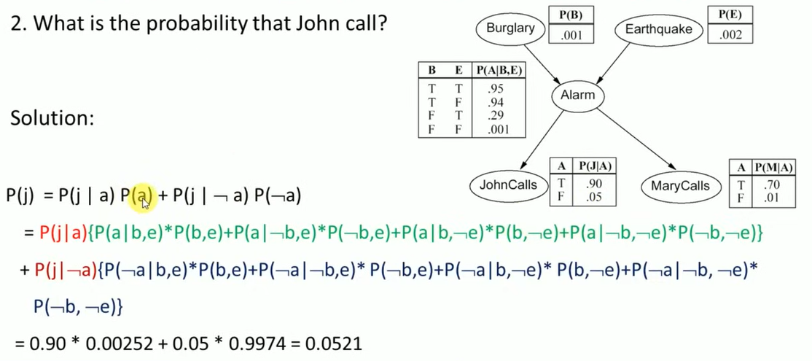
Example of Bayesian Network

Slide 10
Topics on which Week 8 Assignment Questions are based
Random Forest
AdaBoost vs Gradient Boost
Bayesian Networks

Slide 11
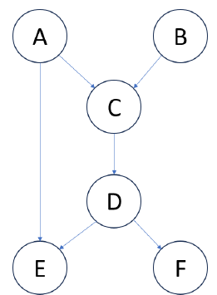
QUESTION 1
1. Consider the Bayesian network given below. Which of the following statement(s) is/are correct?
(a) B is independent of F, given D.
(b) A is independent of E, given C.
(c) E and F are not independent, given D.
(d) A and B are not independent, given D.
SOLUTION 1
There is only one path from B to F, which passes through C. If C is given, then B and F are independent.
There is an edge from A to E. So, A and E are not independent even if C is given.
E and F are children of D. Hence, they are independent if D is given.
D is a descendant of both A and B. Hence, they are not independent if D is given.
CORRECT ANSWER 1
a), d)

Slide 12
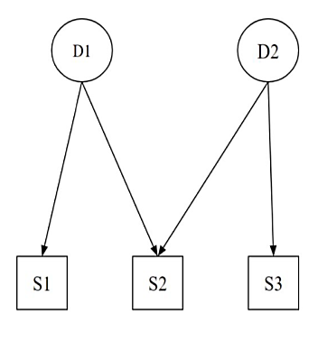
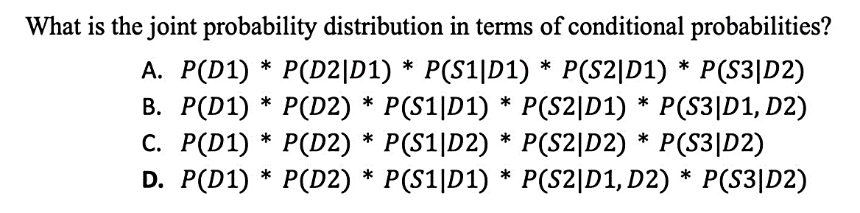
QUESTION 2
SOLUTION 2
From the figure, we can see that D1 and D2 are not dependent on any variable as they don’t have any incoming directed edges. S1 has an incoming edge from D1, hence S1 depends on D1. S2 has 2 incoming edges from D1 and D2, hence S2 depends on D1 and D2. S3 has an incoming edge from D2, S3 depends on D2. Hence, (D) is the answer.
CORRECT ANSWER 2
d)

Slide 13
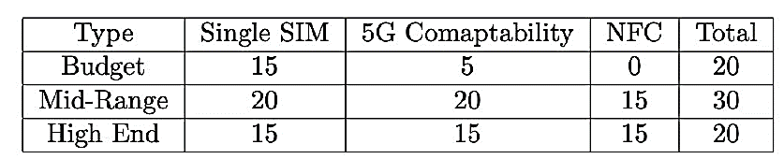
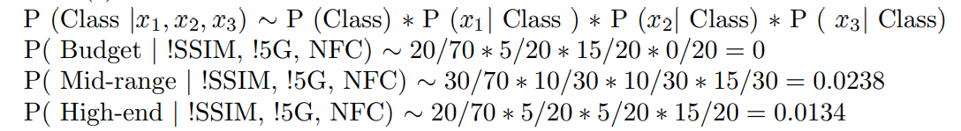
QUESTION 3
Consider the following data for 20 budget phones, 30 mid-range phones, and 20 high-end phones:
Consider a phone with 2 SIM card slots and NFC but no 5G compatibility. Calculate the probabilities of this phone being a budget phone, a mid-range phone, and a high-end phone using the Naive Bayes method. The correct ordering of the phone type from the highest to the lowest probability is?
(a) Budget, Mid-Range, High End
(b) Budget, High End, Mid-Range
(c) Mid-Range, High End, Budget
(d) High End, Mid-Range, Budget
SOLUTION 3
CORRECT ANSWER 3
c)

Slide 14
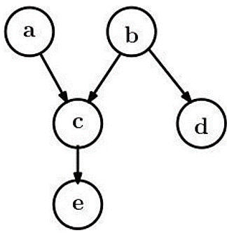
QUESTION 4
Consider the following graphical model. Mark which of the following pair of random variables is independent
c, d
c, e
b, d
a, b
SOLUTION 4
Nodes a and b do not have any common parent
Therefore, they are independent
CORRECT ANSWER 4
d)

Slide 15
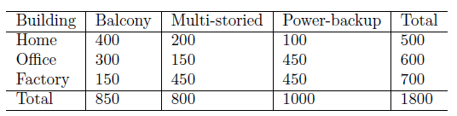
QUESTION 5
Consider the following data for 500 instances of home, 600 instances of office and 700 instances of factory type buildings:
Suppose a building has a balcony and power-backup but is not multi-storied. According to the Naive Bayes algorithm, it is of type
(a) Home
(b) Office
(c) Factory
SOLUTION 5
P(Home|(Balcony & !Multi-storied & Power-backup ) ∝ P(Balcony|Home) * P( !Multi-storied|Home)* P(Power-backup|Home) * P(Home) = 4/5 * 3/5 * 1/5 * 5/18 = 0.027
P(Office|(Balcony & !Multi-storied & Power-backup ) ∝ P(Balcony|Office) * P( !Multi-storied|Office) * P(Power-backup|Office) * P(Office) = 3/6 * 45/60 * 45/60 * 6/18 = 0.094
P(Factory|(Balcony & !Multi-storied & Power-backup ) ∝ P(Balcony|Factory) * P( !Multistoried| Factory) * P(Power-backup|Factory) * P(Factory) = 15/70 * 25/70 * 45/70 * 7/18 =0.019
CORRECT ANSWER 5
b)

Slide 16
QUESTION 6
Which of the following statements is/are true?
Random Forest is an example of ensemble method boosting
Gradient Boosting starts with a leaf
AdaBoost has 8-32 terminal nodes in each tree
Gradient Boosting gives higher weights to more accurate trees whereas AdaBoost gives equal weights to all trees.
SOLUTION 6
Statement (a) – False- Random Forest is an example of ensemble method bagging
Statement (b) –True- Gradient Boosting starts with a leaf
Statement (c) –False- AdaBoost contains only stumps not trees. Gradient Boosting has 8-32 terminal nodes in each tree.
Statement (c) –False- AdaBoost gives higher weights to more accurate trees whereas Gradient Boosting gives equal weights to all trees.
CORRECT ANSWER 6
b)

Slide 17
QUESTION 7
While using Random Forests, if the input data is such that it contains a large number (> 80%) of irrelevant features (the target variable is independent of the these features), which of the following statements are TRUE?
a) Random Forests have reduced performance as the fraction of irrelevant features increases.
b) Random forests have increased performance as the fraction of irrelevant features increases.
c) The fraction of irrelevant features doesn’t impact the performance of random forest.
SOLUTION 7
Random Forests sample a subset of features for each decision tree. Assuming that the number of features in the sample is a fixed fraction of the total number of features, it is easy to see that the greater the fraction of irrelevant features, the more the fraction of useless classifiers (which dilutes the effect of the relevant classifiers).
CORRECT ANSWER 7
a)

Slide 18
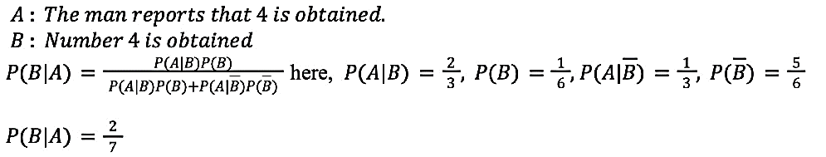
QUESTION 8
A man is known to speak the truth 2 out of 3 times. He throws a die and reports that the number obtained is 4. Find the probability that the number obtained is actually 4 :
2/3
3/4
5/22
2/7
SOLUTION 8
CORRECT ANSWER 8
d)

Slide 19
QUESTION 9
Considering the AdaBoost algorithm, which among the following statements are false?
a) In each stage, we try to train a classifier which makes accurate predictions on any subset of the data points where the subset size is at least half the size of the data set
b) In each stage, we try to train a classifier which makes accurate predictions on a subset of the data points where the subset contains more of the data points which were miscalssified in earlier stages
c) The weight assigned to an individual classifier depends upon the number of data points correctly classified by the classifier
d) The weight assigned to an individual classifier depends upon the accuracy of that classifier
SOLUTION 9
Based on the statements provided about the AdaBoost algorithm, here's an analysis of which ones are false:- Statement a) is false. AdaBoost does not focus on subsets of the data with a specific size. Instead, it focuses on adjusting the weights of misclassified points in each iteration to improve accuracy in subsequent stages, regardless of subset size.- Statement b) is true. In AdaBoost, misclassified points from earlier stages are given more weight in later stages, so the algorithm focuses more on improving the prediction for those data points.- Statement c) is false. The weight assigned to a classifier is not based on the number of correctly classified points but rather on its error rate.- Statement d) is true. The weight assigned to each classifier is indeed based on the accuracy of that classifier.
CORRECT ANSWER 9
b), d)

Slide 20
QUESTION 10
Statement 1: Bayesian Networks always need to be Directed Acyclic Graphs (DAGs)
Statement 2: Each node in a Bayesian network represents a random variable, and each edge represents conditional dependence.
Which of these are true?
Both the statements are True.
Statement 1 is true, and statement 2 is false.
Statement 1 is false, and statement 2 is true.
Both the statements are false.
SOLUTION 10
A DAG means the graph has directed edges (arrows) and no cycles, ensuring that one variable doesn't directly or indirectly influence itself.
Each node in the network represents a random variable while the edges show how one variable is conditionally dependent on another, meaning the state of one variable affects the probability distribution of the connected variable.
CORRECT ANSWER 10
a)

